Slide 1
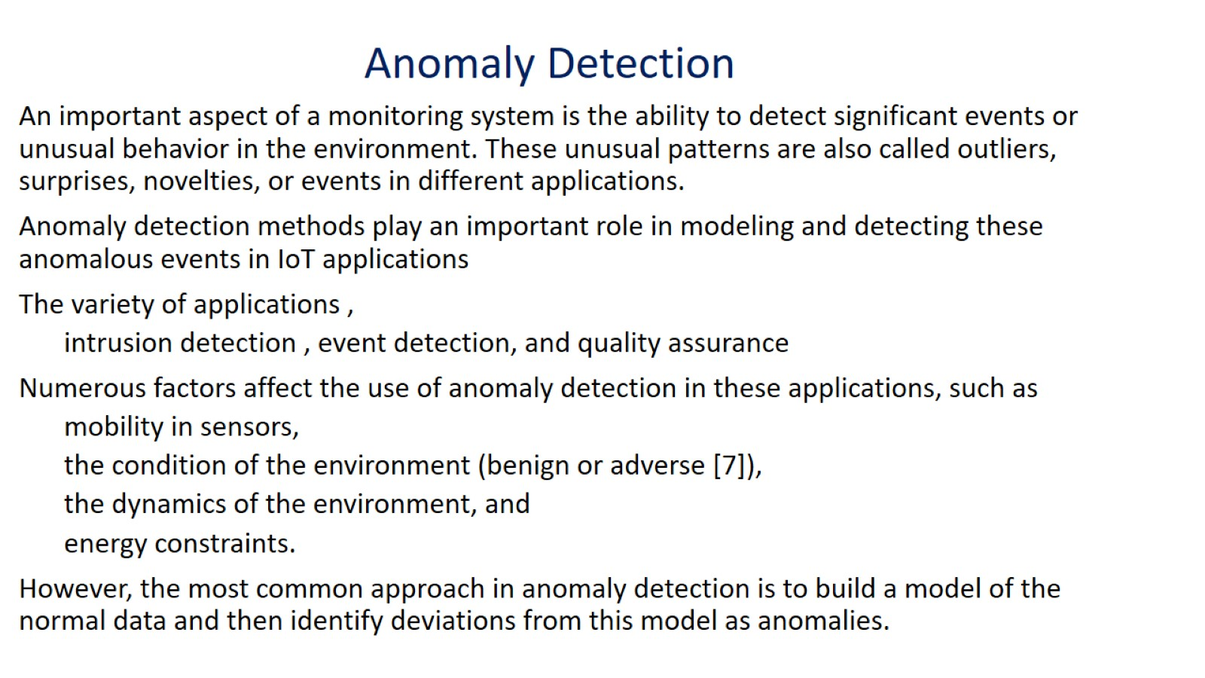

Slide 2
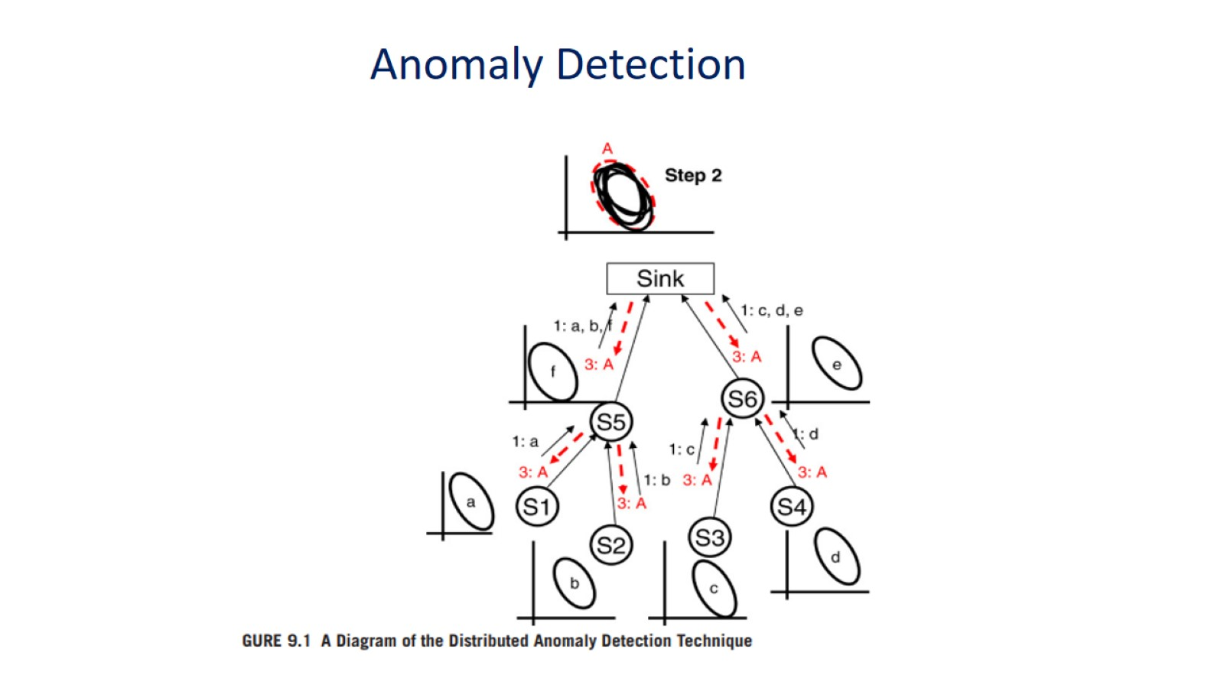
A"sink" typically refers to a device or component that is used to collect, store, or process data generated by IoT devices. IoT devices often produce a vast amount of data, and this data needs to be aggregated, managed, and processed efficiently. A sink plays a crucial role in this data processing pipeline. There are a few common types of sinks in IoT:

Slide 3
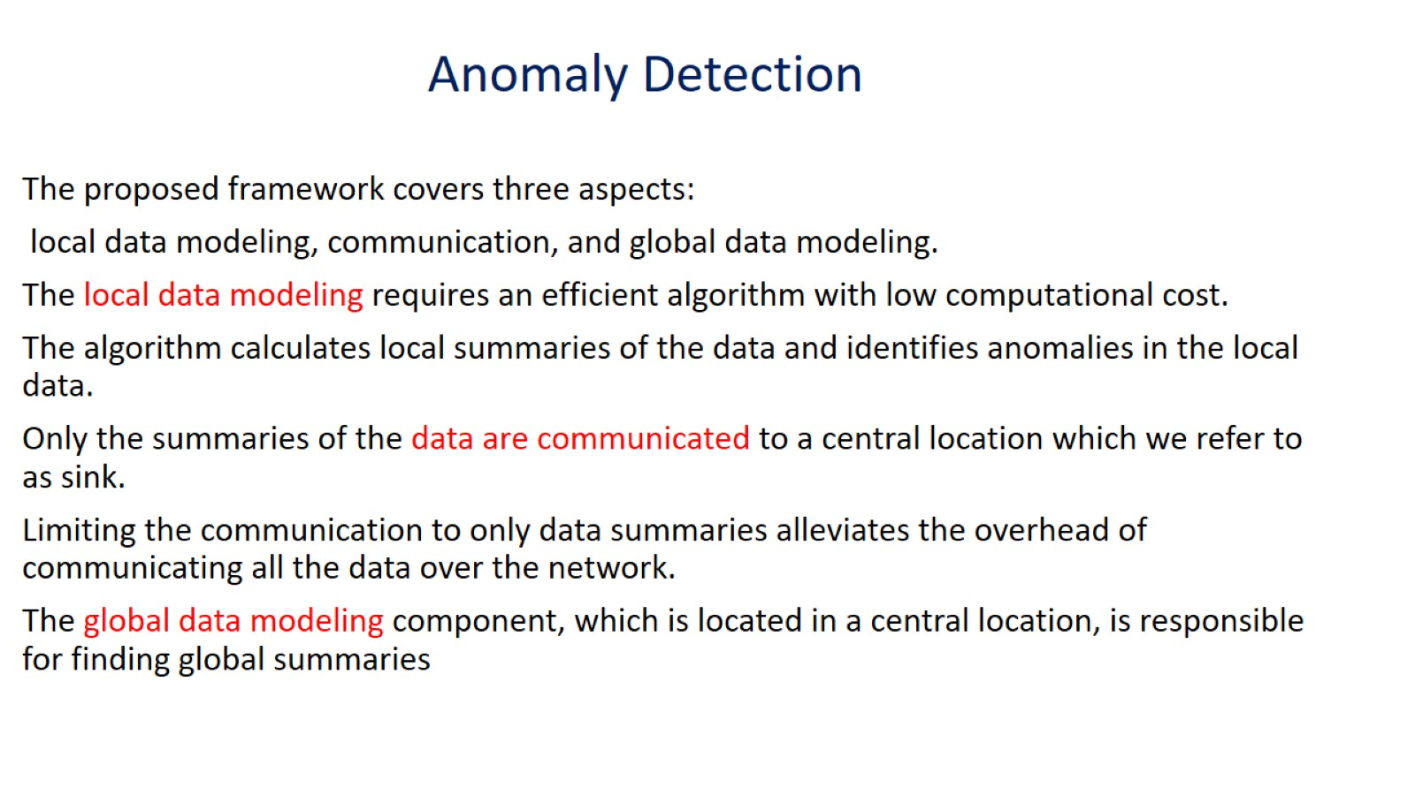

Slide 4
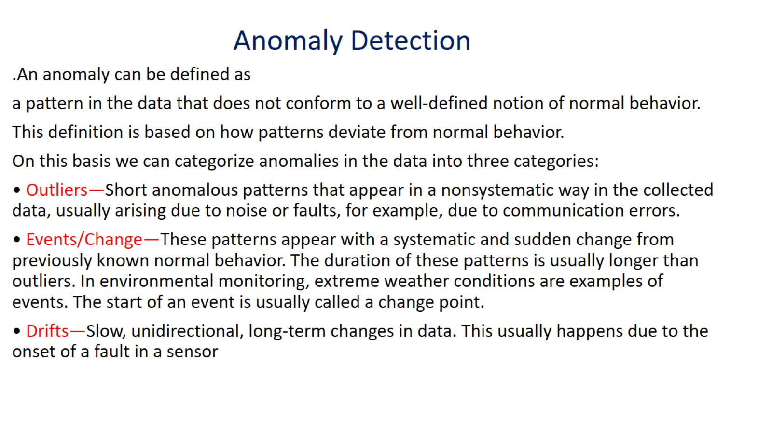

Slide 5
Anomaly detection: Definition
Anomaly detection in the context of the Internet of Things (IoT) refers to the identification of unusual or unexpected behavior, patterns, or events in the data generated by IoT devices.
Anomalies, or outliers, may indicate potential issues, security threats, or valuable insights. Detecting anomalies in IoT data is crucial for ensuring the reliability, security, and efficiency of IoT systems.

Slide 6
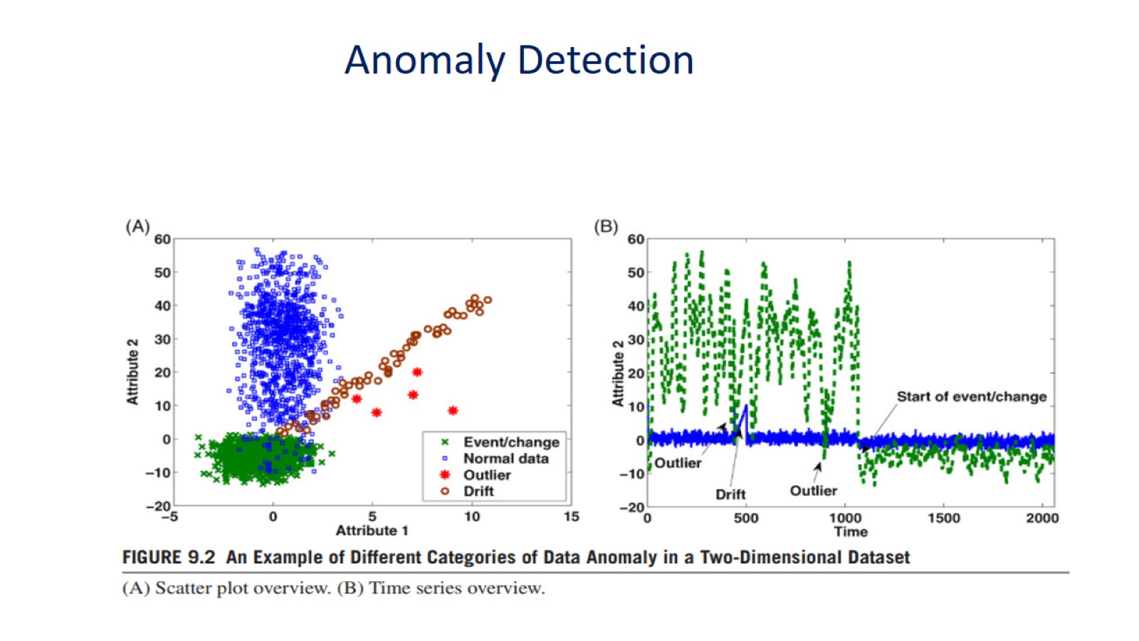

Slide 7
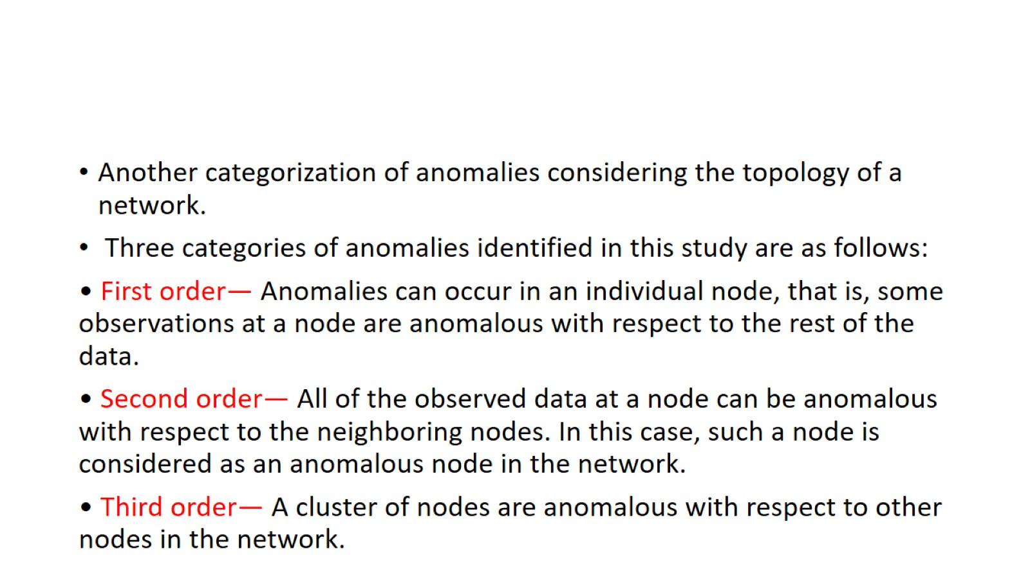
Topology-based anomaly detection in the Internet of Things (IoT) focuses on monitoring the network topology and identifying unusual or unexpected changes in the structure of the network

Slide 8

